Slide 1
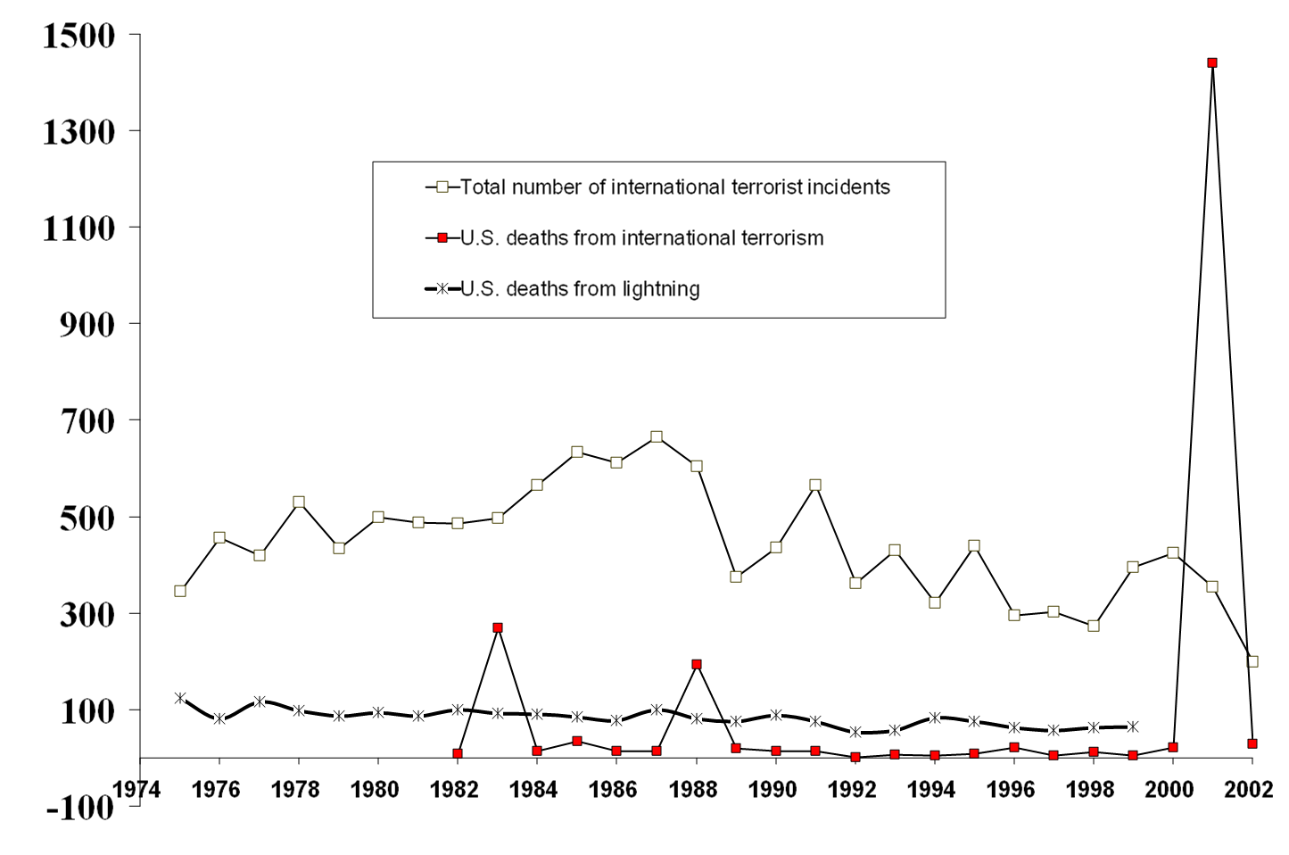
International Terrorism and Lightning
Previous high: 329 in 1985 when Air India plane blown up by Sikhs

Slide 2
Nuclear weapons:
The mass production and widespread distribution of increasingly sophisticated and increasingly powerful man‑portable weapons will greatly add to the terrorist's arsenal and the world's increasing dependence on nuclear power may provide terrorists with weapons of mass destruction.
--Brian Jenkins, 1975

Slide 3
To secure as much of our way of life as possible, we will have to use military force in the way Americans used it on the fields of Virginia and Georgia, in France and on the Pacific islands, and from skies over Tokyo and Dresden. Progress will be measured by the pace of killing and, yes, by body counts. Not the fatuous body counts of Vietnam, but precise counts that will run to extremely large numbers. The piles of dead will include as many or more civilians as combatants because our enemies wear no uniforms. Killing in large number is not enough to defeat our Muslim foes. With killing must come a Sherman‑like razing of infrastructure. Roads and irrigation systems; bridges, power plants, and crops in the field; fertilizer plants and grain mills‑‑all these and more will need to be destroyed to deny the enemy its support base. Land mines, moreover, will be massively reintroduced to seal borders and mountain passes too long, high, or numerous to close with U.S. soldiers. As noted, such actions will yield large civilian casualties, displaced populations, and refugee flows.
--Anonymous, Imperial Hubris (2004), pp. 241-42

Slide 4
Bin Laden goal: overreaction
It is easy for us to provoke and bait....All that we have to do is to send two mujahidin...to raise a piece of cloth on which is written al‑Qaeda in order to make the generals race there to cause America to suffer human, economic, and political losses. Our policy is one of bleeding America to the point of bankruptcy. The terrorist attacks cost al‑Qaeda $500,000 while the attack and its aftermath inflicted a cost of more than $500 billion on the United States.

Slide 5
Risk of death for an American over a 50-year period
Botulism 1 in 2,000,000
Fireworks 1 in 1,000,000
Tornado 1 in 50,000
Airplane crash 1 in 20,000
Electrocution 1 in 5,000
Firearms accident 1 in 2,000
Automobile accident 1 in 100
Asteroid impact 1 in 6,000
Notes:
New York Times, June 18, 1991, p. C1. Source: Clark R. Chapman and David Morrison

